Slide 1
Fall 2021 Precalc
Lesson 16.2
Dr. O’Brien
Herbert H. Lehman High School
11 January 2022
Notes:
make google form to submit published code.
make google meet link for better live coding experience.

Slide 2
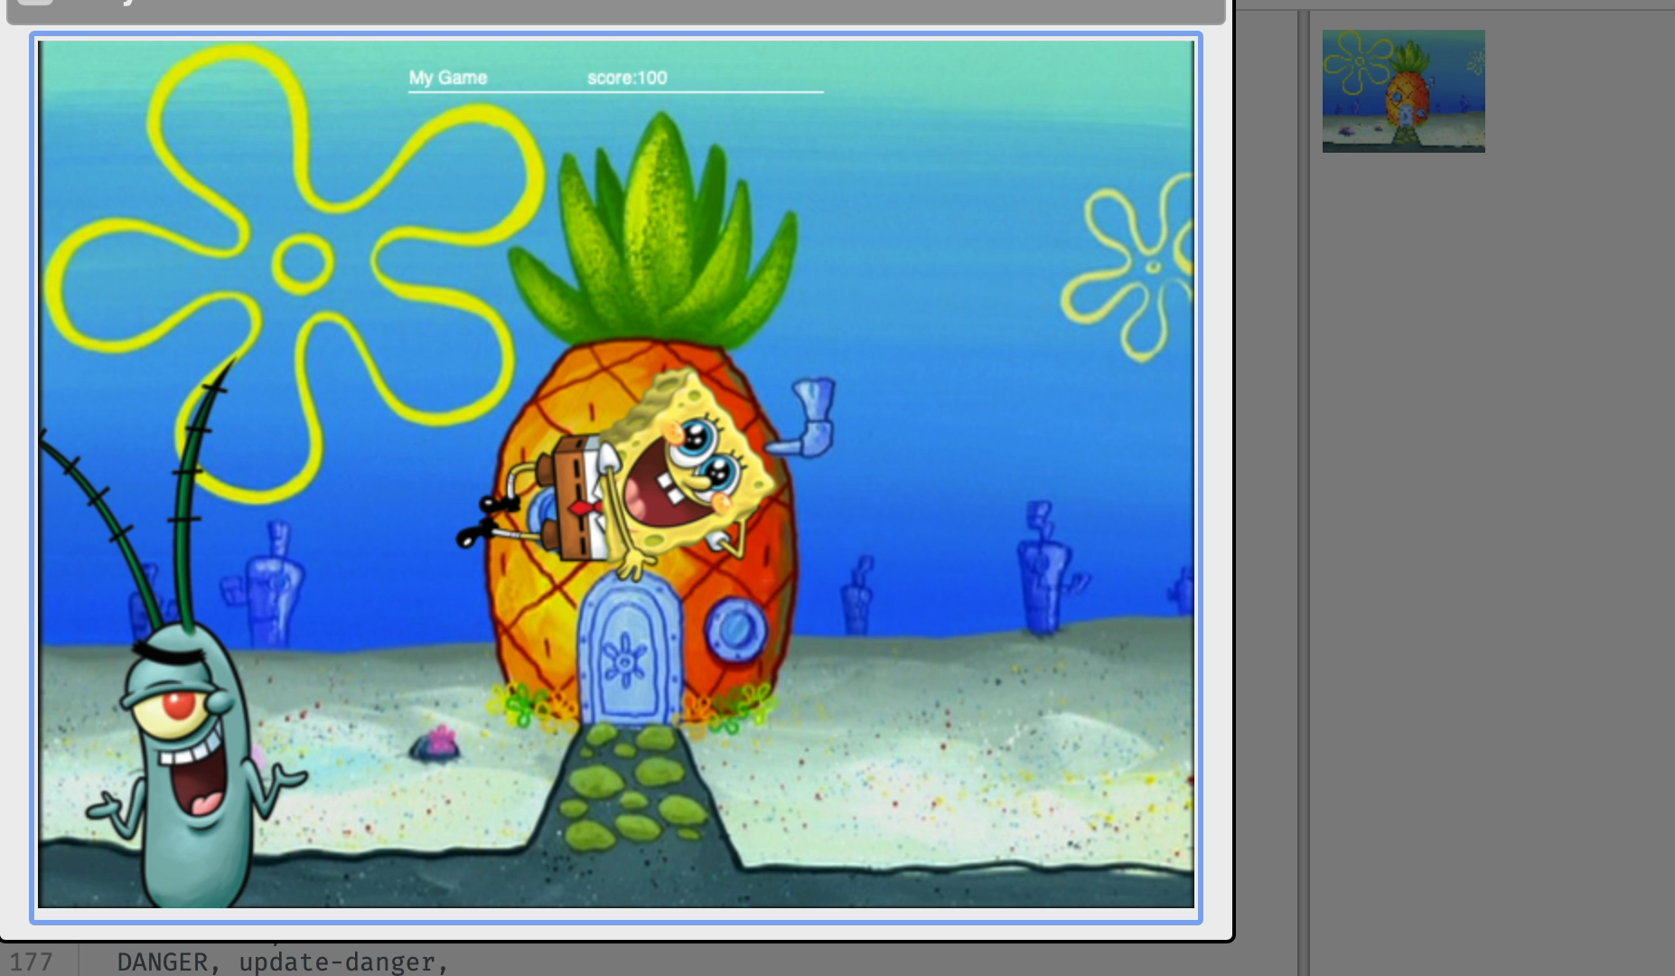
Do now
Grading rubric
Below is the grading rubric for your Pyret video game. Please complete with your partner this week. I'm making Monday and Tuesday workdays in class. On Wednesday we'll start new material.
To receive a C:
Add your own images for player, danger, and target
Make sure the danger and target are moving horizontally, by modifying the update-danger() and update-target() functions
Make sure that the player can move up and down, by modifying the update-player() function
To receive a B:
Use the distance formula to finish the distance() function. The finish the is-collision() function.
To receive a A:
use the posn() function to make sure the characters in the game can move in more interesting directions.
Extra credit:
Make sure that the danger or target follow the path of a quadratic function (see example game).
Be sure to:
Find a seat near the front. Get out your notebook and binder. Copy today’s goal.
Read through the grading rubric to the right. Write down what grade you would get if you submitted your project now.
Write down any other questions you have.
Notes:
At the end, have students who are finished with everything, stay at the desks to talk through the extra credit problem together.

Slide 3
B24 rules
Welcome to our new room, B24! Please read the information below:
When you come in, please find a seat at a desk (if one’s available) or one of the six closest desks to the screen. Do not sit in the back of the classroom. We’ll conduct the do now and mini lesson from here.
When I dismiss you for independent work, find a sit at one of the computer workstations.
No food or drink by the computers.
At the end of the period, you’ll be directed to assemble for the exit ticket/debrief. Log out of your computer, and quietly return to a seat near the front.

Slide 4
Coding to learn: Work Day
Grading rubric
Below is the grading rubric for your Pyret video game. Please complete with your partner this week. I'm making Monday and Tuesday workdays in class. On Wednesday we'll start new material.
To receive a C:
Add your own images for player, danger, and target
Make sure the danger and target are moving horizontally, by modifying the update-danger() and update-target() functions
Make sure that the player can move up and down, by modifying the update-player() function
To receive a B:
Use the distance formula to finish the distance() function. The finish the is-collision() function.
To receive a A:
use the posn() function to make sure the characters in the game can move in more interesting directions.
Extra credit:
Make sure that the danger or target follow the path of a quadratic function (see example game).
Be sure to:
If you haven’t finished your project (except extra credit), go to your computer. Continue working!
If you’re ready for extra credit, remain at the front desks.
The distance formula:
$$d=\sqrt{(x2-x1)^{2}+(y2-y1)^{2}}$$

Slide 5
Coding to learn: extension Activity
Be sure to: Carefully follow the instructions below:
Now is your time to customize your game! Try implementing some of the following features, or make your own!
Warping - program one key to "warp" the player to a set location, such as the center of the screen
Boundaries - change update-player such that PLAYER cannot move off the top or bottom of the screen
Wrapping - add code to update-player such that when PLAYER moves to the top of the screen, it reappears at the bottom, and vice versa
Hiding - add a key that will make PLAYER seem to disappear, and reappear when the same key is pressed again
Reminder: Use # to add comments to code!
Adding useful comments to code is an important part of programming. It lets us leave messages for other programmers, leave notes for ourselves, or "turn off" pieces of code that we don’t want or need to debug later.
Notes:
+How can I move to the left and write? experiment with using the posn(x,y) function.
+example of fully implemented update-player function:
fun update-player(x, y, key):
ask:
| (key == "up") and (y >= 480) # Wrap from top to bottom
then: posn(x, 0)
| (key == "down") and (y <= -120) # Wrap from bottom to top
then: posn(x, 480)
| (key == "up") # default up
then: posn(x, y + 10)
| (key == "down") # default down
then: posn(x, y - 10)
| (key == "left") # default up
then: posn(x - 10, y)
| (key == "right") # default down
then: posn(x + 10, y)
|otherwise: posn(x, y) # any other key
end
end

